Slide 1
Introduction to Programming

Slide 2
Object-oriented programming (OOP)
Object-oriented programming (OOP) is a programming paradigm based on the concept of "objects“.
Object may contain data, in the form of fields, often known as attributes; and code, in the form of procedures, often known as methods.
For example, a person is an object which has certain properties such as height, gender, age, etc. It also has certain methods such as move, talk, and so on.

Slide 3
Object
This is the basic unit of object-oriented programming.
Objects are like real-life entities. They have their properties and methods.
That is both data and function that operate on data are bundled as a unit called an. Object
Eg:
Consider a car as an object. The car has so many characteristics like colour, company name, modal name and price, etc.
we can perform actions like start, break, and stop these are the methods

Slide 4
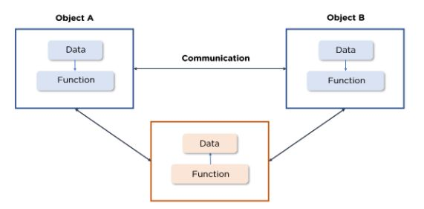

Slide 5
Class
Class is a blueprint of a real-life entity.
It describes how the object will look alike, what characteristics it holds and what kind of actions we can perform on it.

Slide 6
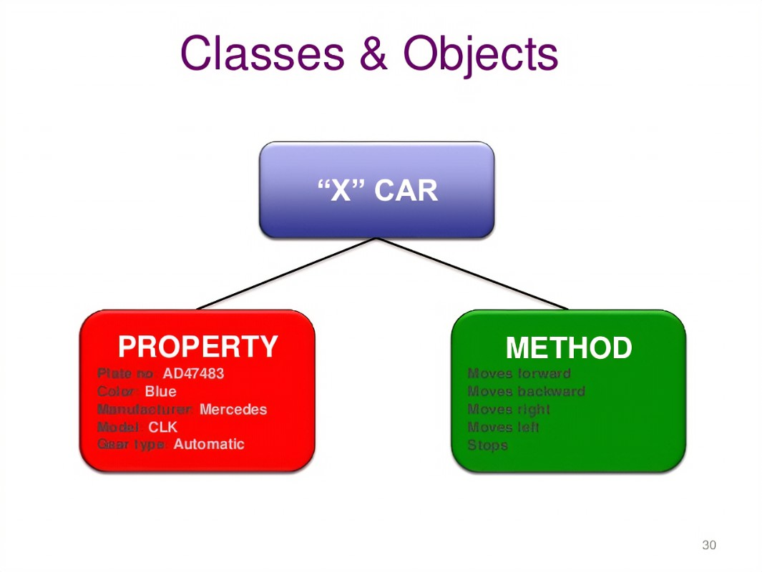
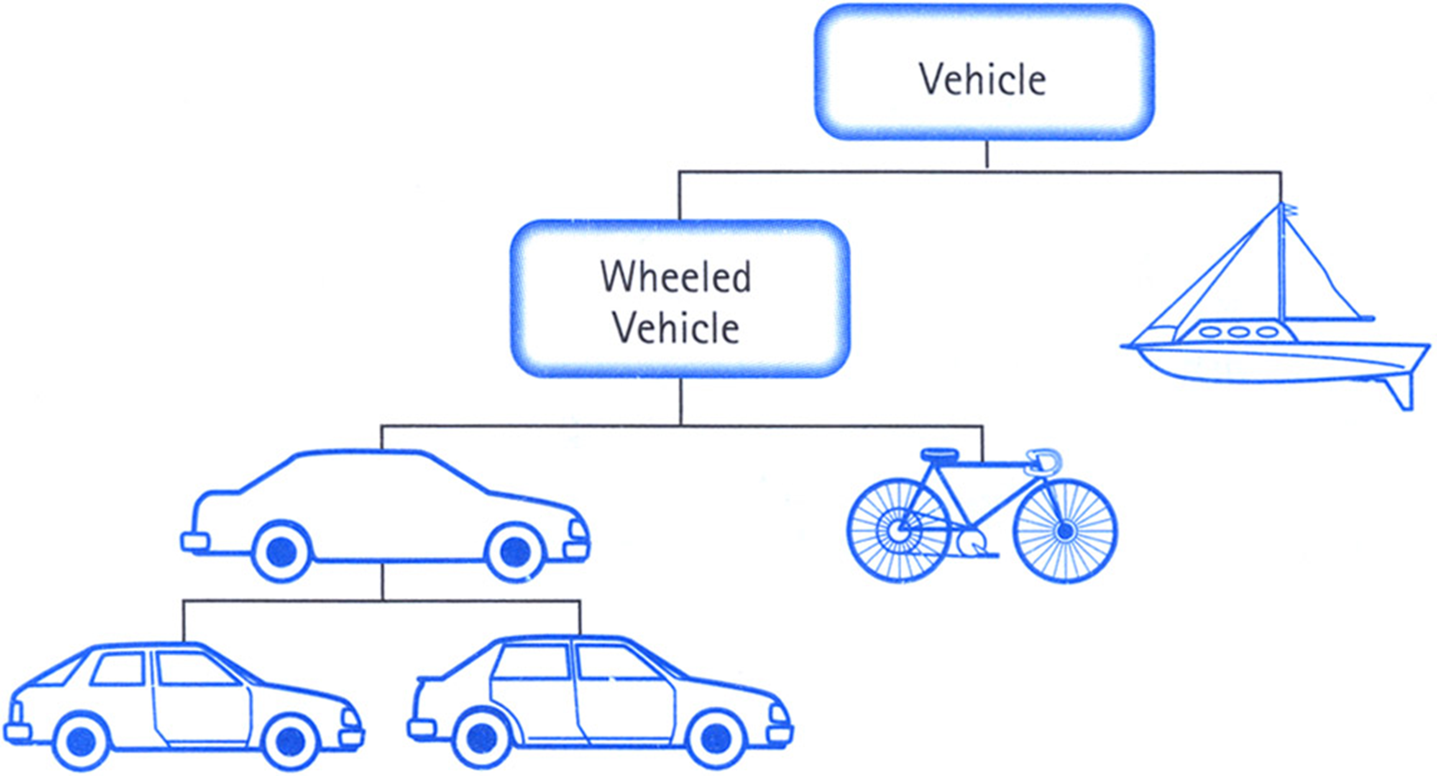
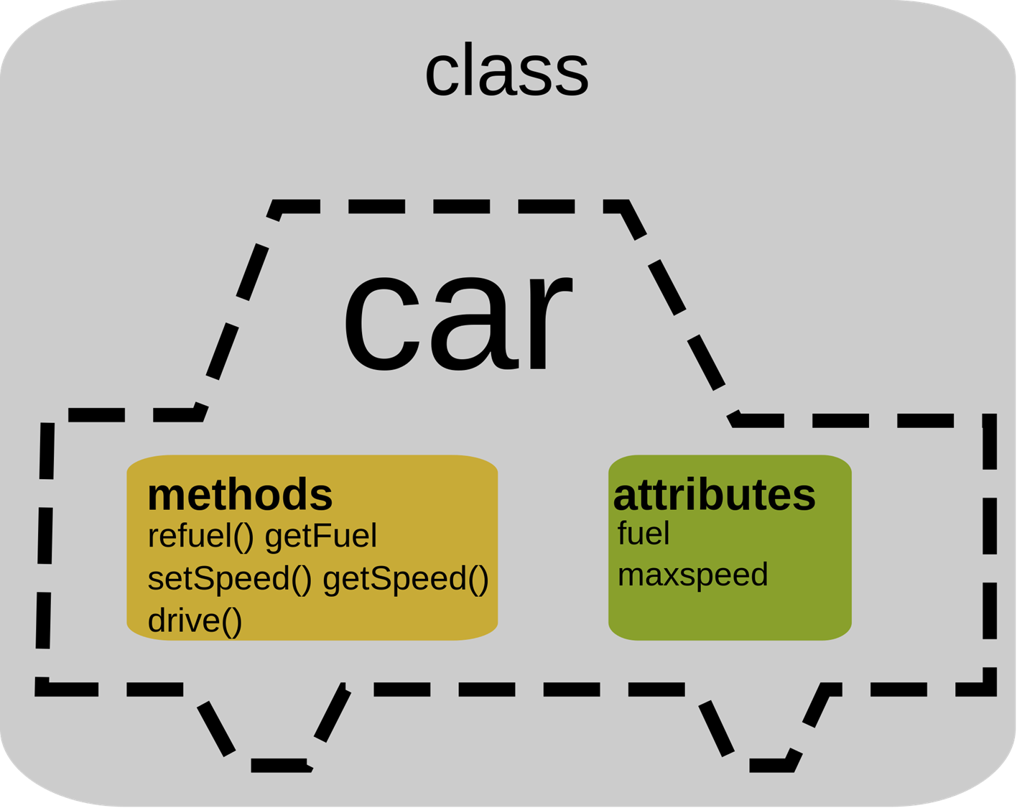

Slide 7
OOP has four basic concepts on which it is totally based.
Abstraction
Encapsulation
Inheritance
Polymorphism

Slide 8
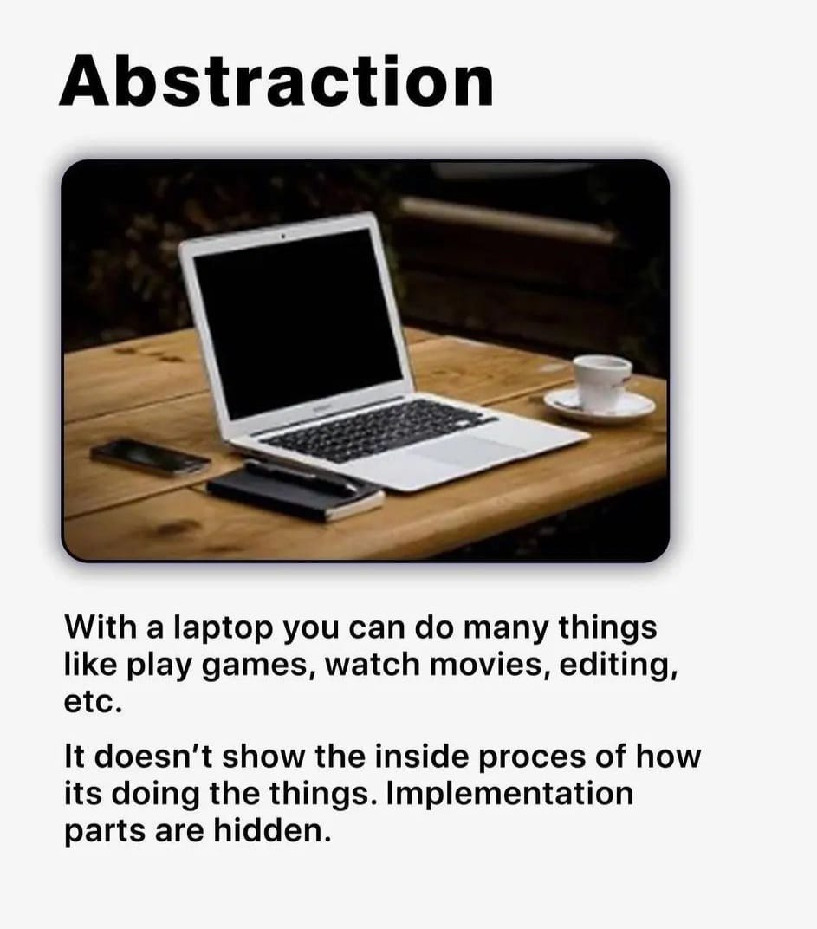
Abstraction
It refers to, providing only essential information to the outside world and hiding their background details.

Slide 9
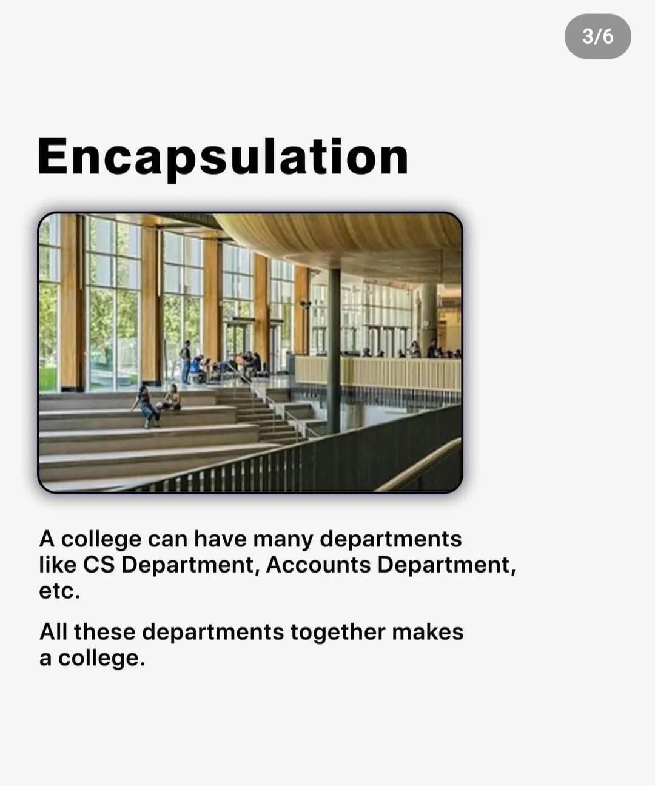
Encapsulation
Encapsulation is a process of binding data members (variables, properties) and member functions (methods) into a single unit.
It is also a way of restricting access to certain properties or component. The best example for encapsulation is a class.

Slide 10
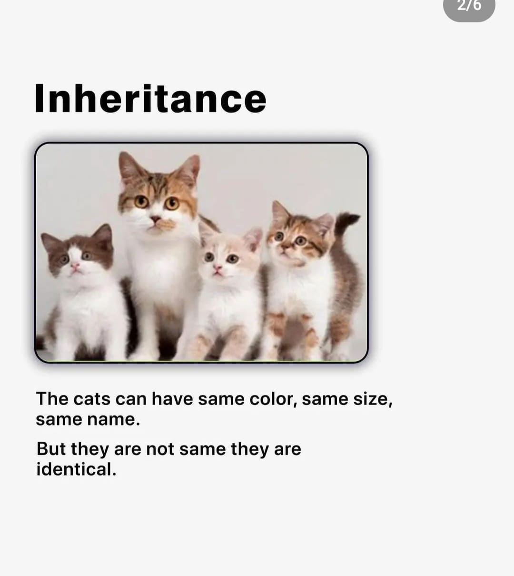
Inheritance
The ability to create a new class from an existing class is called Inheritance.
Using inheritance, we can create a Child class from a Parent class such that it inherits the properties and methods of the parent class and can have its own additional properties and methods.

Slide 11
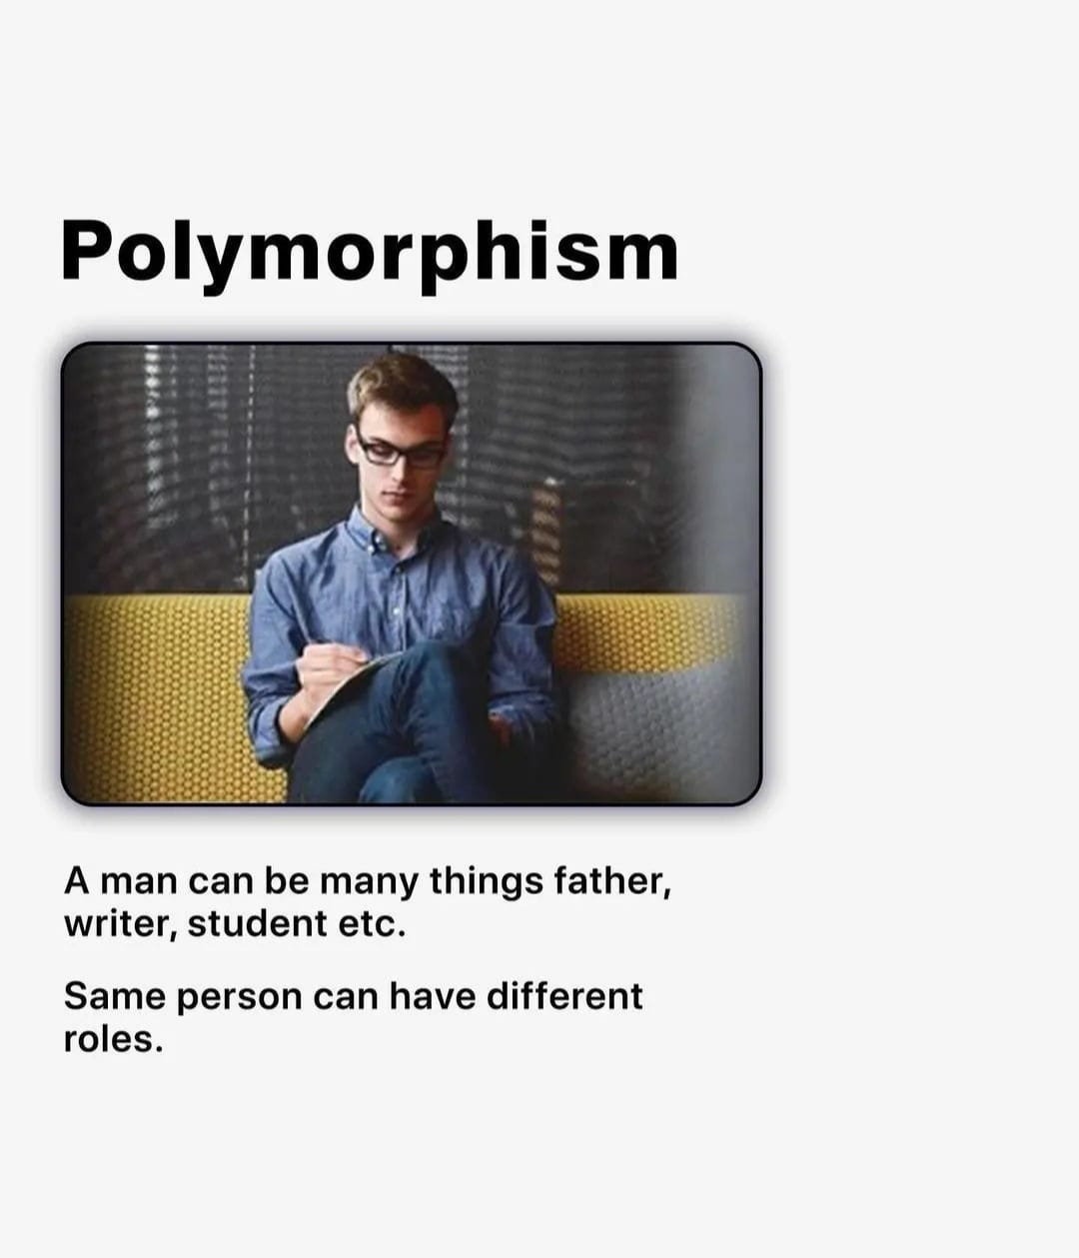
Polymorphism
The word polymorphism means having many forms.
Polymorphism occurs when there is a hierarchy of classes and they are related by inheritance.

Slide 12
Data structure
Data structure is a particular way of storing and organizing data in a computer so that it can be used efficiently.
eg: Array, stack, tree, heap, hash table.

Slide 13
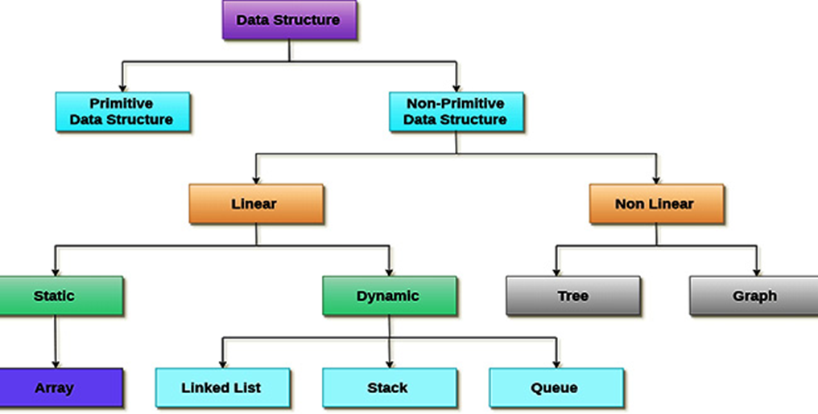
Data structure

Slide 14
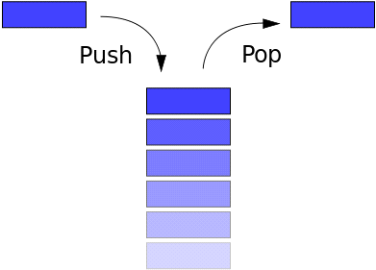
Stack
A stack is a particular data type or collection in which the main operations are the addition of an item, known as push, and removal of it, known as pop.
Stacks implement a LIFO (Last In First Out) structure which means that the last element added to the structure must be the first one to be removed.

Slide 15
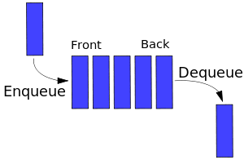
Queue
Queues are collection that keep objects in a certain order while applying the FIFO (First in First out) format. It is just like a line of people, except that data doesn't cut in it.
Adds an item at the front of the queue. The process is the same as PUSH from stack, but I changed for the sake of the exercise.

Slide 16
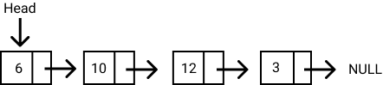
Linked list
Linked lists are data structures that are made of groups of nodes which together represent a sequence.

Slide 17
Algorithms
Writing a logical step-by-step method to solve the problem is called the algorithm.
In other words, an algorithm is a procedure for solving problems.
In order to solve a mathematical or computer problem, this is the first step in the process.
An algorithm includes calculations, reasoning, and data processing. Algorithms can be presented by natural languages, pseudocode, and flowcharts, etc.

Slide 18
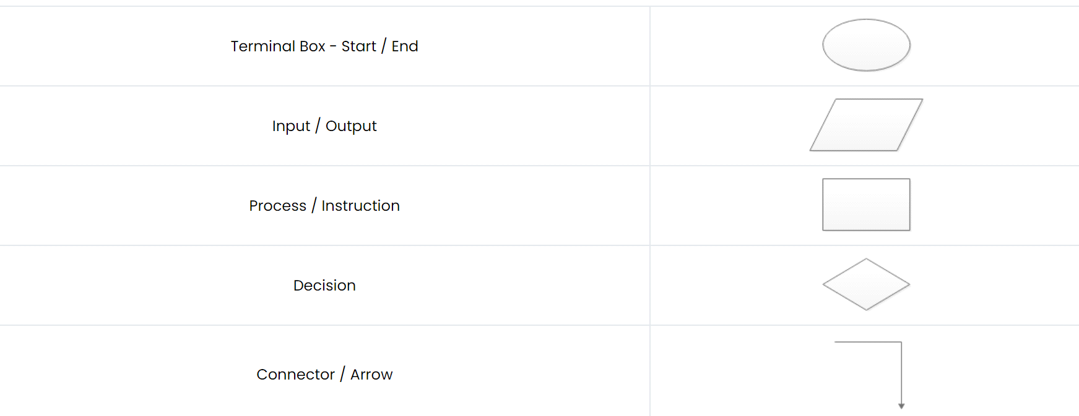
Flowchart
Flowcharting is the process of drawing a flowchart for an algorithm. The flowchart uses various symbols in the representation.

Slide 19
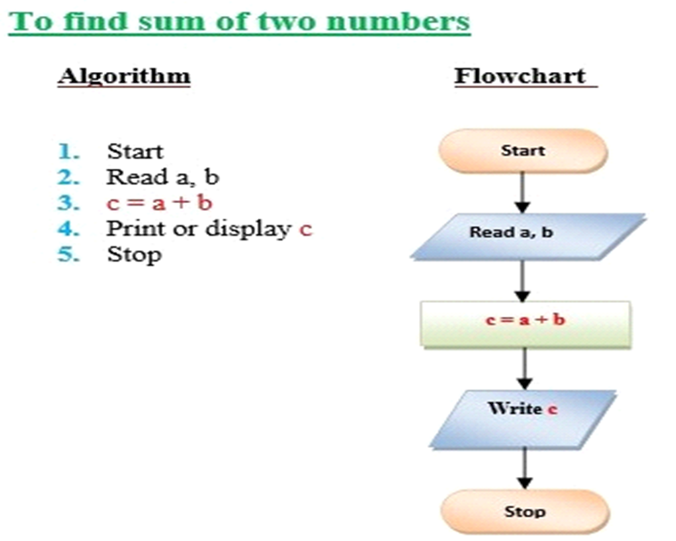

Slide 20
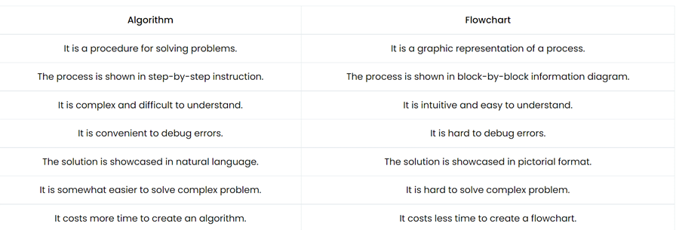

Slide 21
ES6
ECMAScript, or ES, is a standardized version of JavaScript.
Because all major browsers follow this specification, the terms ECMAScript and JavaScript are interchangeable.
Most of the JavaScript you've learned up to this point was in ES5 (ECMAScript 5), which was finalized in 2009. While you can still write programs in ES5, JavaScript is constantly evolving, and new features are released every year.
ES6, released in 2015, added many powerful new features to the language. these new features including arrow functions, destructuring, classes, promises, and modules.

Slide 22
Download Node.js
Official Node.js website has installation instructions for Node.js: https://nodejs.org
Node v16.16.0 (LTS)
Windows 32-bit Installer: https://nodejs.org/dist/v16.16.0/node-v16.16.0-x86.msi Windows 64-bit Installer: https://nodejs.org/dist/v16.16.0/node-v16.16.0-x64.msi

Slide 23
JavaScript basics
JavaScript is the world's most popular programming language.
JavaScript is easy to learn.
JavaScript is a powerful programming language that can add interactivity to a website.
It was invented by Brendan Eich.

Slide 24
1.JavaScript Programs
A computer program is a list of "instructions" to be "executed" by a computer.
In a programming language, these programming instructions are called statements.
A JavaScript program is a list of programming statements.

Slide 25
2. JavaScript Statements
JavaScript statements are composed of:
Values, Operators, Expressions, Keywords, and Comments.
Most JavaScript programs contain many JavaScript statements.
The statements are executed, one by one, in the same order as they are written.

Slide 26
3. Semicolons ;
Semicolons separate JavaScript statements.
Add a semicolon at the end of each executable statement:
Eg let a, b, c;

Slide 27
4. Keywords
JavaScript statements often strart with a keyword to identify the JavaScript action to be performed.
JavaScript keywords are reserved words. Reserved words cannot be used as names for variables.

Slide 28
Keyword Description
var Declares a variable
let Declares a block variable
const Declares a block constant
function Declares a function
returnif Marks a block of statements to be executed on a condition
switch Marks a block of statements to be executed in different cases
for Marks a block of statements to be executed in a loop
try Implements error handling to a block of statements

Slide 29
Variables
Variables are containers that store values.
JavaScript uses the keywords var, let and const to declare variables.
Variables allow computers to store and manipulate data in a dynamic fashion. They do this by using a "label" to point to the data rather than using the data itself.
By declaring a variable with the let keyword, followed by the name you give to the variable:
let myVariable;

Slide 30
Initializing a variable
An equal sign is used to assign values to variables.
After declaring a variable, you can give it a value:
myVariable = 20;
Also, you can do both these operations on the same line:
let myVariable = 20;

Slide 31
Declaring a variable
// declaring single variable
var name;
// declaring multiple variables
var name, title, num;
// initializing variables
var name = "Harsh";
name = "Rakesh";

Slide 32
4 Ways to Declare a JavaScript Variable:
Using nothing
Using var
Using let
Using const

Slide 33
Identifiers
JavaScript identifiers are the name that we give to variables, objects, functions, arrays, classes, etc. We must use a unique name so as to identify them.
We then use the identifier to refer to the variable, functions, etc elsewhere in the program.
There are certain rules & restrictions that we must follow when we name an identifier.
Eg: var message =”hello world”;

Slide 34
JavaScript Identifiers Rules
The identifier name must be unique within the scope.
The first letter of an identifier should be a upper case letter, Lower case letter, underscore, dollar sign.
The subsequent letters of an identifier can have upper case letter, Lower case letter, underscore, dollar sign, numeric digit
We cannot use reserved keywords. You can find the list of keywords for here.
They are case-sensitive. For Example, sayHello is different from SayHello
Cannot use spaces in a identifier name.
Avoid using the JavaScript Reserved Keywords as identifier name

Slide 35
JavaScript console.log() Method
The console.log() is a function in JavaScript that is used to print any kind of variables defined before in it or to just print any message that needs to be displayed to the user.
Syntax:
console.log(“Code with Me");
var a = 2;
console.log(a);
var str = “LUMINAR TECHNOLAB";
console.log(str);

Slide 36
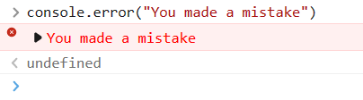
JavaScript console.error() Method
Outputs an error message to the console

Slide 37
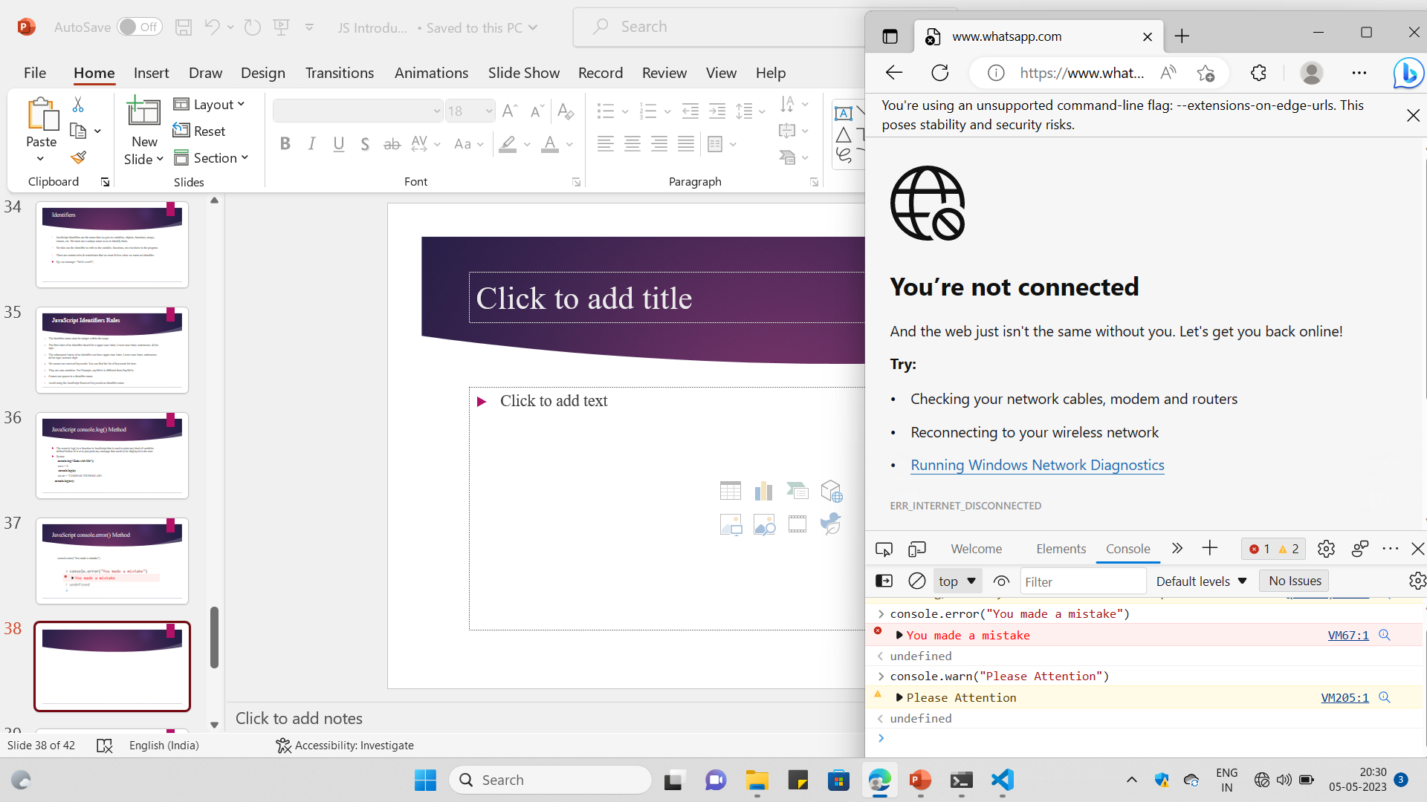
JavaScript console.warn() Method
Outputs a warning message to the console

Slide 38
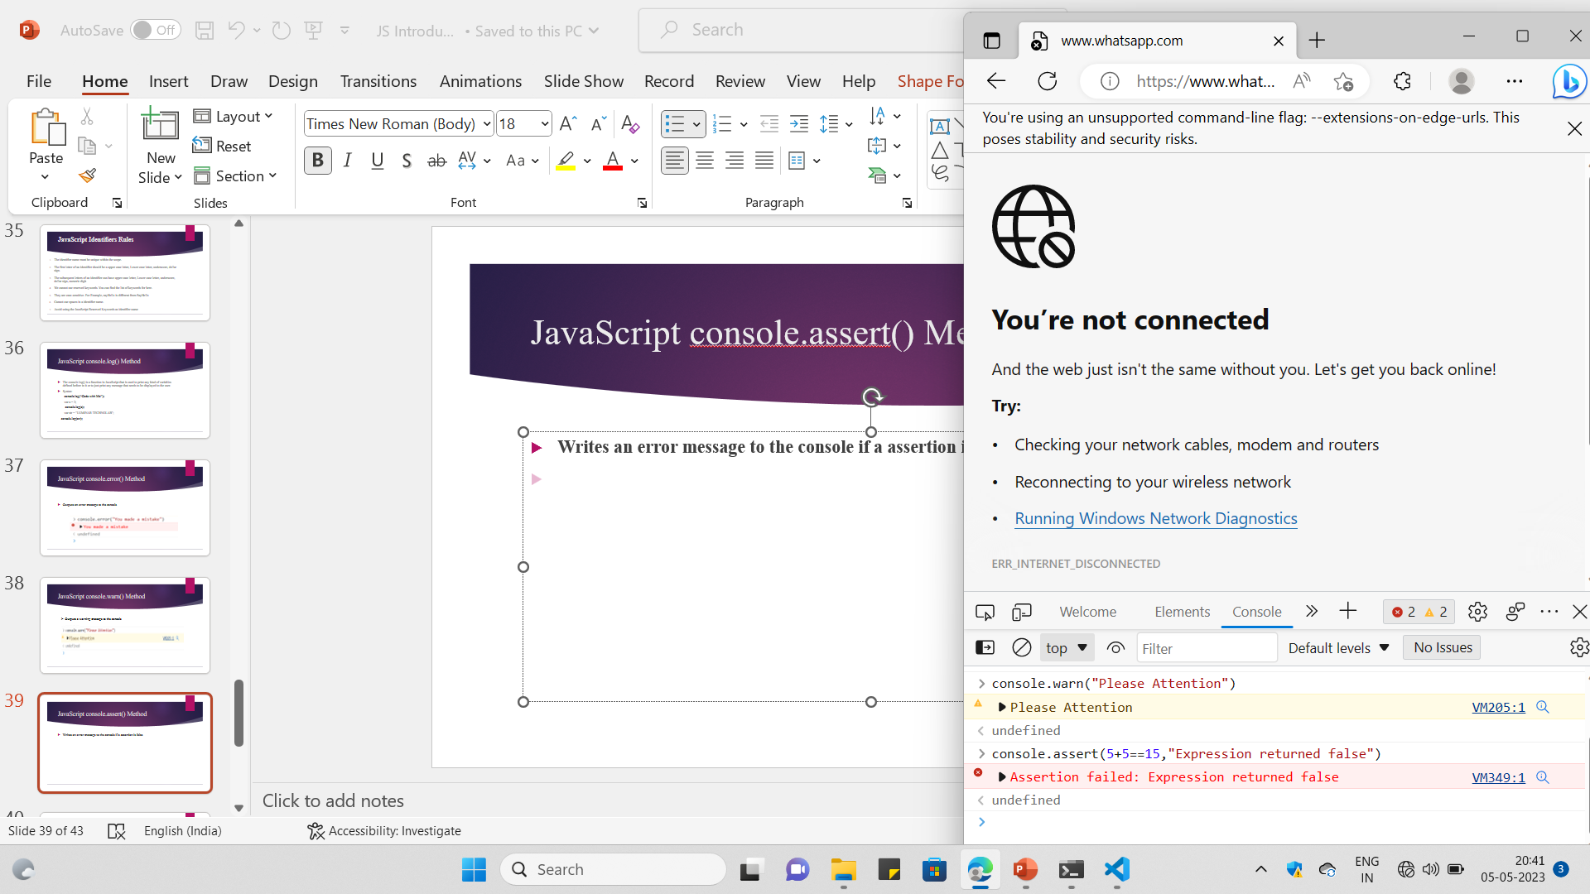
JavaScript console.assert() Method
Writes an error message to the console if a assertion is false

Slide 39
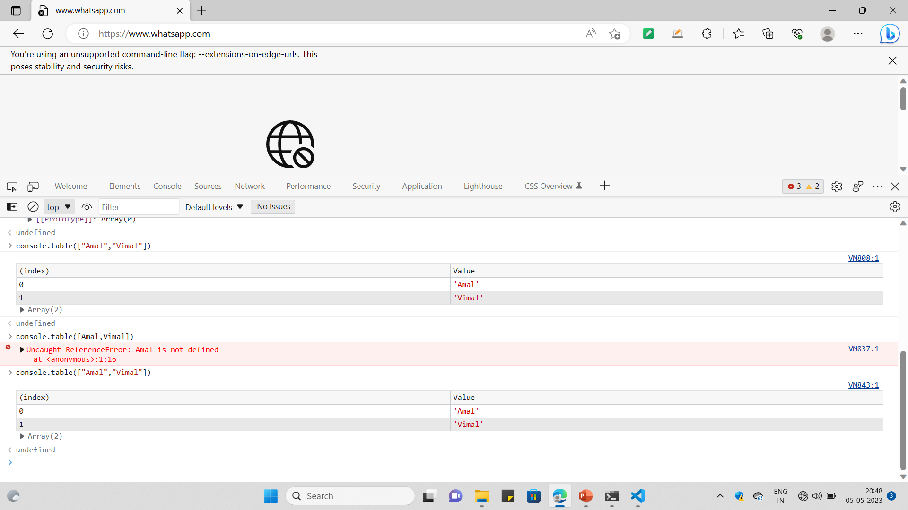
JavaScript console.table() Method

Slide 40
JavaScript console.clear() Method
Clear the console

Slide 41
Comments
Not all JavaScript statements are "executed".
Code after double slashes // or between /* and */ is treated as a comment.
Comments are ignored, and will not be executed

Slide 42
JavaScript and Camel Case
Historically, programmers have used different ways of joining multiple words into one variable name:
Hyphens:
first-name, last-name, master-card, inter-city.
Hyphens are not allowed in JavaScript. They are reserved for subtractions.

Slide 43
Underscore:
first_name, last_name, master_card, inter_city.
Upper Camel Case (Pascal Case):
FirstName, LastName, MasterCard, InterCity.
Lower Camel Case:
JavaScript programmers tend to use camel case that starts with a lowercase letter:
firstName, lastName, masterCard, interCity.
snakecase- get_input

Slide 44
TASKS
Task 1: Difference between var, let, const.
Task 2:What are the features of java script

